Slide 1
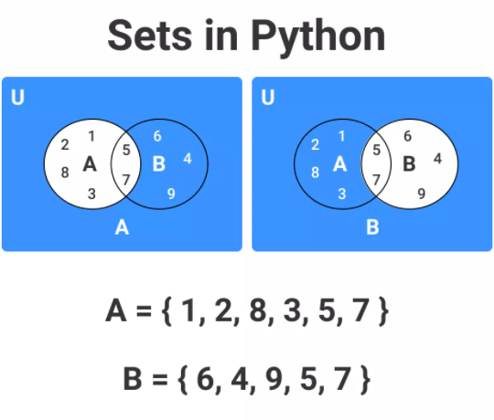
Sets In Python
Set is an unordered collection of items.
Elements in set are unique ( No Duplicate elements ).
To create an empty set you have to use set(), not { }

